Slide 1
ENGR 11: Introduction to
Engineering Analysis I
GS 138
Dr. Mandala

Slide 2
Recap
Use built-in functions (using range ‘:’ and set values ‘,’)
Add new worksheets and copy existing worksheets
SORT data
Use the function VLOOKUP
Apply conditional formatting
FILTER data
Create PLOTS

Slide 3
VLOOKUP
vlookup(lookup value, table array, col index num, [range lookup])
lookup value: value you wish to lookup in the table array
table array: table array (the range in the worksheet where the table is stored)
col index number: appropriate column in lookup table array where the value has to be returned from
range lookup (optional entry) finds exact match (if set to false) or approximate match (if set to true or omitted)

Slide 4
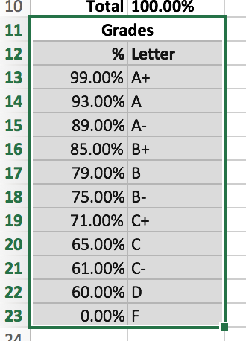
VLOOKUP
=vlookup(Q26,Grades,2,TRUE)

Slide 5
Today
Solving equations graphically (Manual) and numerically in Excel

Slide 6
quiz (NO grades!)
What is an equation? How do you typically write it down?
How do you solve an equation?
What is a quadratic equation? How do you solve it using calculator?

Slide 7
Solving Equations
Given a quadratic function f(x) = y = ax² + bx + c, where a, b, and c are real numbers and a≠0, how can we use Excel to solve for x when f(x)=y=0? In other words, how can we find the roots of this quadratic function?
Graphically
Manual approach
Numerically
Newton-Raphson method (Excel’s Goal Seek)
Other optimization methods (Excel’s Solver)

Slide 8








Overview of quadratic equation
quadratic equation
roots
PAPER & PENCIL EXAMPLE
Find the roots of:
three possible forms
real (distinct) roots
complex roots
repeated roots

Slide 9
graphical approach
Let’s find the roots of f(x) = x² - 3x + 1 graphically
APPROACH
Setup preliminary variables
Plot the function
Find zero crossings (locations where the curve crosses the x-axis)
Trap a root between bracketing values, and then “hunt it down like a rabbit*”
*Numerical Recipes in C. The Art of Scientific Computing. Second Edition, Press et al., Cambridge University Press, 1992
Notes:
Draw plot and show approximations

Slide 10
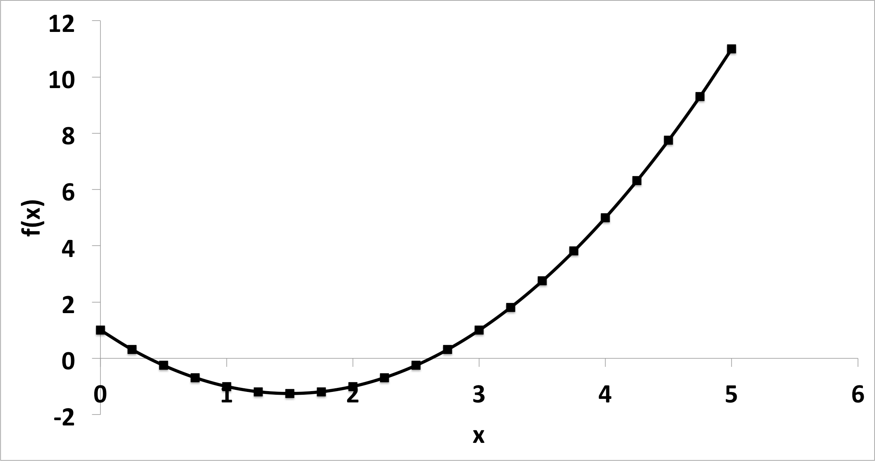
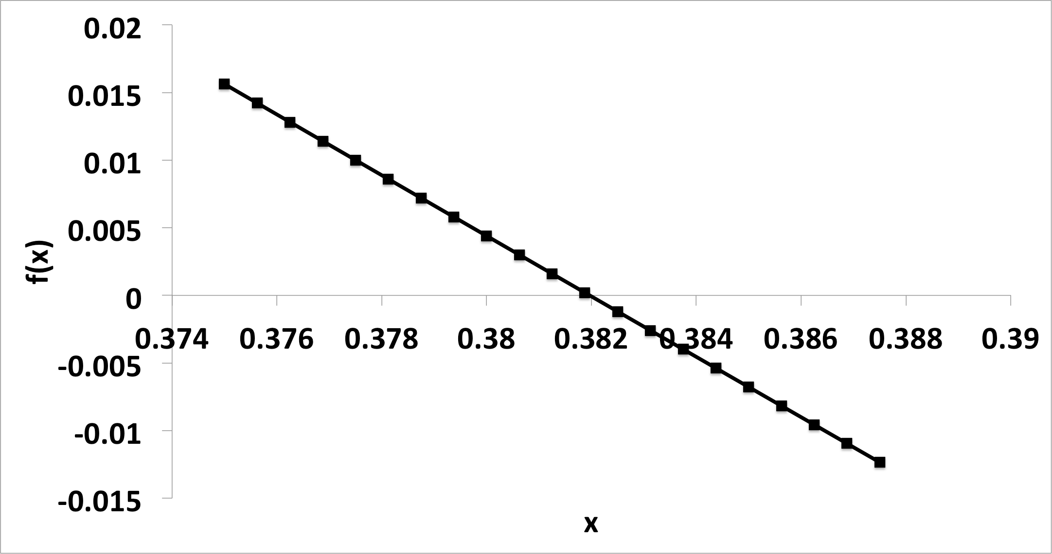
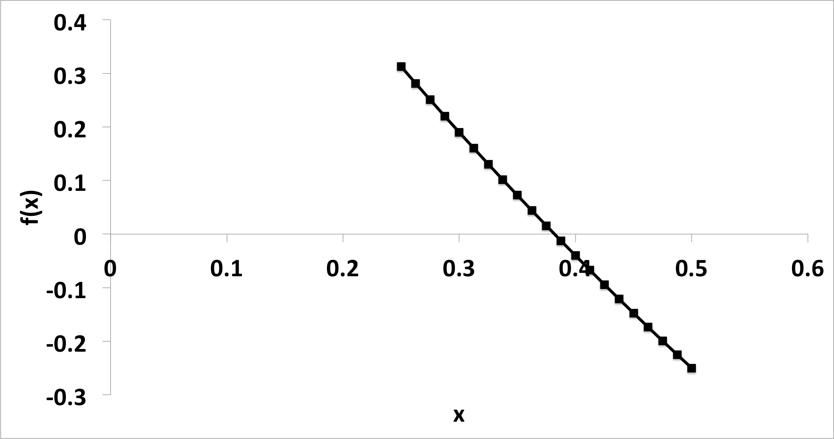
Graphical (manual) approach
Iteration 1
Iteration 3
Iteration 2

Slide 11

NUMERICAL Approach
Find solution through approximations and iterations
Program keeps trying new solution and compares with previous iteration
Stops when desired difference is reached
Several algorithms, most popular is Newton Method
Evaluates the function (equation) and its derivative
Very very good if initial estimate is close to solution
If x_{(i)} is root of equation f(x), then:

Slide 12
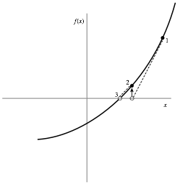
Newton-Raphson method
Notes:
x(i+1) is the X intercept of tanget line

Slide 13
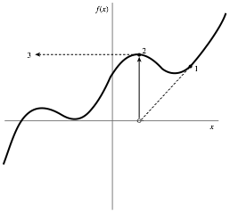
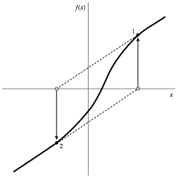
Doesn't work in all cases

Slide 14
In class activity
Download all class handouts from Week-3 (Handout-2)

Slide 15
acknowledgment
Based on work by Prof. Arash Mahboobin

